Slide 1
Single Page Web App: Manchester Tech Meetups
by Sean O’Mahoney (@Sean12697)

Slide 2
Who?
Computer Science at Manchester Metropolitan University
Prolific Networker: ~200 Networking Events Attended
Hackathons: 1st Place once, 2nd place three times, lost none
Workshops/Talks: Run 5, done 16 times
Likes Web & Data stuffs, does Photography
@Sean12697

Slide 3
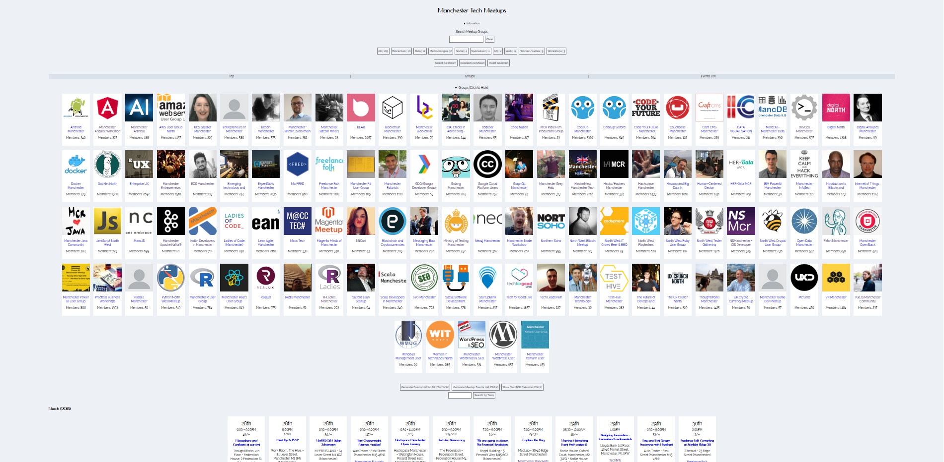
What? (http://mcrmeetup.tech/)
Essentially, a service which will allow you to find Meetup Groups, their events, and filter through both.
@Sean12697
Notes:
[Small Demo]

Slide 4
Inspiration / Research
Spotify Playlist Generator - https://www.youtube.com/watch?v=eV3WkDAM3Hw
GitHub Repository Video - https://github.com/lets-learn/spotify-playlist-generator
Meetup RESTFUL API - https://www.meetup.com/meetup_api/
@Sean12697
Notes:
What made me create this? Well, it was partly due to attending such events where I know there were many groups (being in roughly 60+ at the time), which others have not heard of and would like, combined with the usually watching of YouTube videos, the main being this “Spotify Playlist Generator, which used the Spotify RESTful API in JavaScript. This made me research if Meetup had its own RESTful API service, which it had (that many products have now).

Slide 5
How to get there?
MVP! MVP! MVP!!! (Minimum Viable Product)
Ideas (Features):
Show All Meetups
Search
Filter into Categories
Show Events
Filter Events
TechNW Integration
Sorting
Activity
Essential Features:
Show All Meetups
Show Events
Search
MVP:
Show All Meetups
Release:
+ Show Events
+ Search
Iteration x:
+ Filters
@Sean12697
Notes:
You might have a lot of ideas for features, which is great and should be noted, although you should narrow them down to essential ones, then from there get an MVP, the minimum you need for it to work, even for a prototype, then iterate with features over time and testing.

Slide 6
MVP
API Call compared from the tutorial, to research from the Meetup API
app.getAlbumTracks = (id) => $.ajax({
url: `https://api.spotify.com/v1/albums/${id}/tracks`,
method: 'GET',
dataType: 'json'
});
app.getMeetups = (meetup) => $.ajax({
url: 'https://api.meetup.com/' + meetup,
method: 'GET',
dataType: 'jsonp'
});
@Sean12697

Slide 7
MVP
Function calls to the API compared from the tutorial, to what’s needed for the Meetup API
app.getTracks = function(tracks) {
$.when(...tracks)
.then((...tracks) => {
tracks = tracks
.map(getDataObject)
.reduce((prev,curr) => [...prev,...curr],[]);
const randomPlayList = getRandomTracks(50,tracks);
app.createPlayList(randomPlayList);
})
};
function initGetMeetups() {
console.log(meetups);
MeetupsJSON = MeetupsJSON.map(app.getMeetups);
$.when(...MeetupsJSON)
.then((...MeetupsJSON) => {
MeetupsJSON = MeetupsJSON.map(a => a[0].data);
console.log(MeetupsJSON); // MVP
});
}
“meetups” & “MeetupJSON” = ["android_mcr", "BCS-Greater-Manchester-Branch“,.. ]
$.when & .then are async’ call, .then doing the anonymous function once complete
.map(a => a[0].data) to remove the JSONP padding ([0]), then async’ promise (.data)
@Sean12697

Slide 8
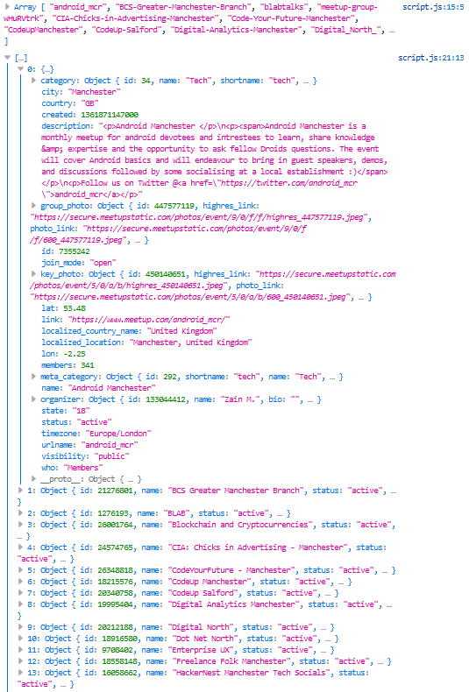
MVP (Console Logs)
Whoop!
@Sean12697

Slide 9
MVP (Display & Responsiveness)
What do we need? (Image, Name, Members).
How should elements be, how do they change (thinking about CSS in Media Queries).
Container (Div) = inline-block
Picture and Text Elements
Text Align: Centre or Left
NAME
MEMBERS
NAME
MEMBERS
NAME
MEMBERS
NAME
MEMBERS
@Sean12697

Slide 10
MVP (Resulting HTML)
<div class="group" id="0">
<div class="meetupImg">
<img src="https://secure.meetupstatic.com/photos/event/9/0/f/f/600_447577119.jpeg">
</div>
<div class="groupText">
<a href="https://www.meetup.com/android_mcr/" target="_blank">
<p class="groupName">Android Manchester</p>
</a>
<p>Members: 341</p>
</div>
</div>
@Sean12697

Slide 11
MVP (Resulting CSS)
.group {
display: inline-block;
width: 150px;
height: 280px;
margin: 10px;
overflow: hidden;
background-color: #fff;
transition-duration: 0.4s;
}
.group:hover {
transform: scale(1.1);
}
.groupText {
margin: 5px;
}
@media only screen and (min-width: 324px) and (max-width: 480px) {
.group {
width: 100%;
height: 100px;
margin: 8px 0px;
text-align: left;
overflow: hidden;
}
.group label {
width: 100px;
height: 100px;
padding: 0px;
margin: 0px;
display: inline-block;
overflow: hidden;
}
.group img {
object-fit: cover;
width: 150px;
height: 150px;
padding-bottom: 0px;
}
.groupName {
height: 40px;
overflow: hidden;
}
.meetupImg {
display: inline-block;
vertical-align: top;
}
.groupText {
padding: 0px 10px;
display: inline-block;
width: 50%;
}
.groupName {
margin: 0px;
margin-top: 10px;
}
.group img {
object-fit: cover;
width: 100px;
height: 100px;
padding-bottom: 0px;
}
.groupText p {
margin: 10px;
margin-left: 0px;
}
}
@Sean12697

Slide 12
MVP (Resulting JavaScript)
function drawMeetups(JSON) {
groupsContainer.innerHTML = "";
for (var i = 0; i < JSON.length; i++) {
var x = JSON[i];
var name = x.name;
var link = x.link;
var members = x.members;
var thumb = 'blank.jpg';
if (x.hasOwnProperty('group_photo')) {
thumb = x.group_photo.photo_link;
} else {
if(x.hasOwnProperty('organizer')) {
if (x.organizer.hasOwnProperty('photo')) {
thumb = x.organizer.photo.photo_link;
}
}
} groupsContainer.insertAdjacentHTML('beforeend', '<div class="group" id="' + i + '"><div class="meetupImg"><img src="' + thumb + '"></div><div class="groupText"><a href="' + link + '" target="_blank"><p class="groupName">' + name + '</p></a><p>Members: ' + members + '</p></div></div>');
}
}
Clear our container (which will have a loader)
Go through each object in our returned JSON
Put the content we need in variables
Do error correction on some (don’t make assumptions)
Generate HTML and insert it within a container element (which has been defined)
@Sean12697

Slide 13
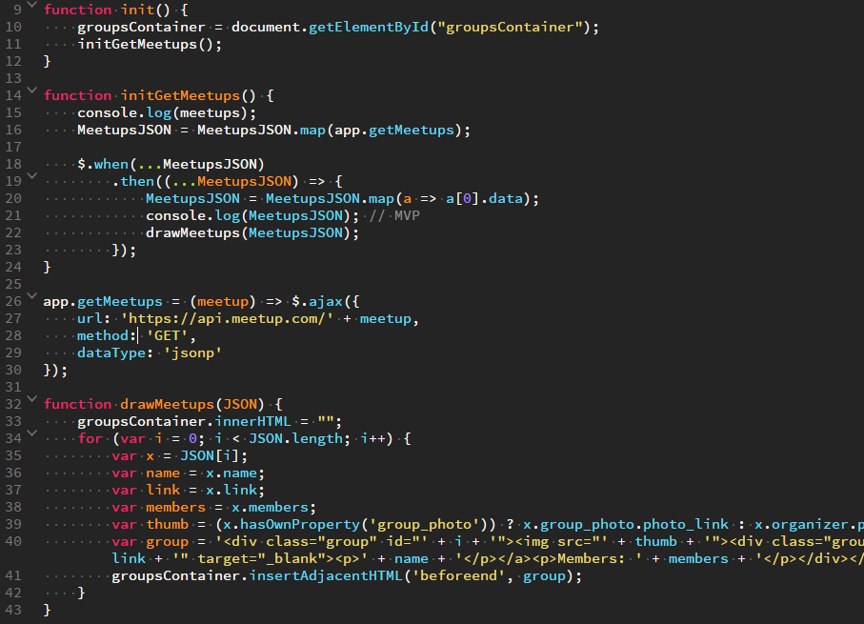
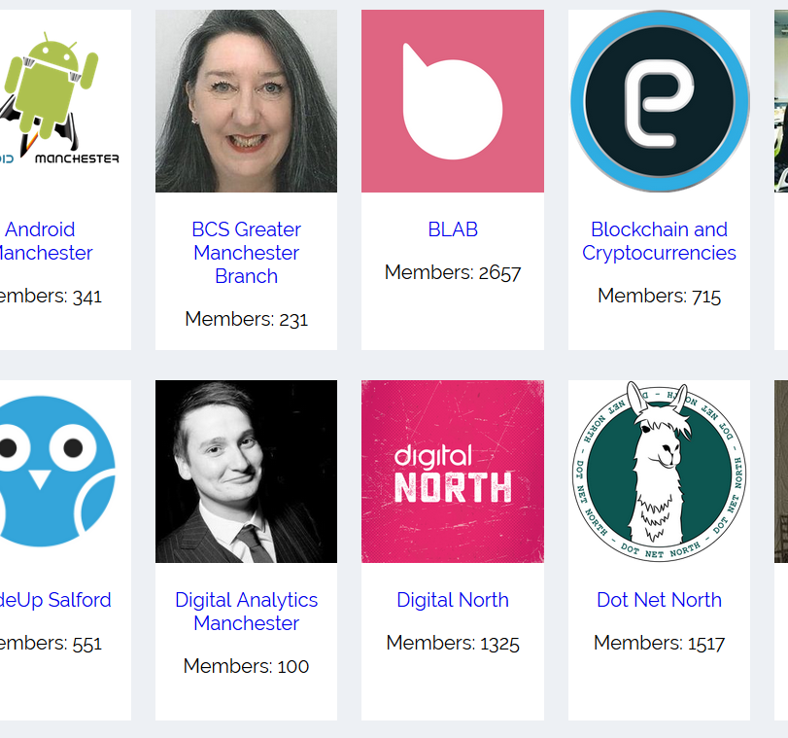
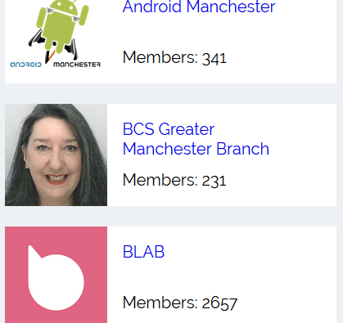
MVP Complete (“Show All Meetups”)
Within 43 lines of JavaScript
@Sean12697

